Slide 1

Filtering in Pandas 3: Merges

Slide 2
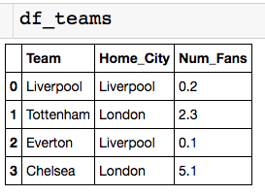
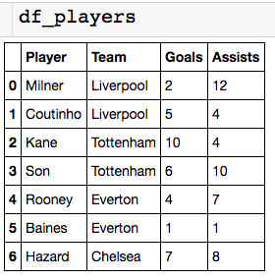
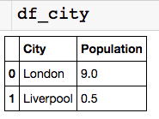
Toy Soccer Data Set
What fraction of the population does each team’s fan base make up?
How many goals are scored by players in London?

Slide 3
Basic JOIN Operation
What fraction of the population does each team’s fan base make up?
First we need to add a population column to df_teams

Slide 4

Inner Merge Operation
Left dataframe
Right dataframe
Type of merge
Columns to match up

Slide 5
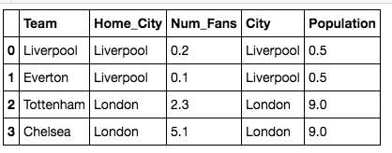
Inner Merge Operation
Left dataframe
Right dataframe
Type of merge
Columns to match up

Slide 6
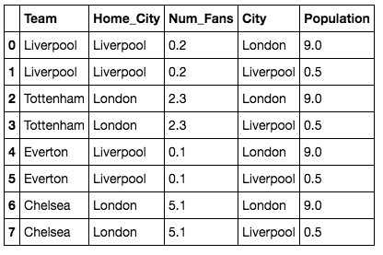
Inner Merge Operation
What happened…
Columns to match up

Slide 7
Inner Merge Operation
What happened…Only keep columns where Home_City = City
Columns to match up

Slide 8
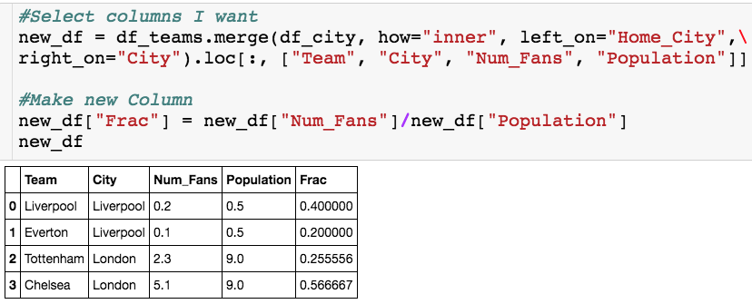
Answer Question 1
What fraction of the population does each team’s fan base make up?

Slide 9
Inner Merge Operation
How many goals are scored by players in London?

Slide 10
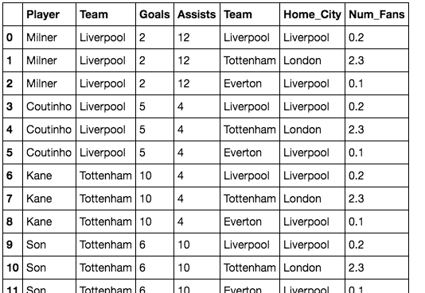
Inner Merge Operation
What do I merge on?
Which columns do I need?

Slide 11
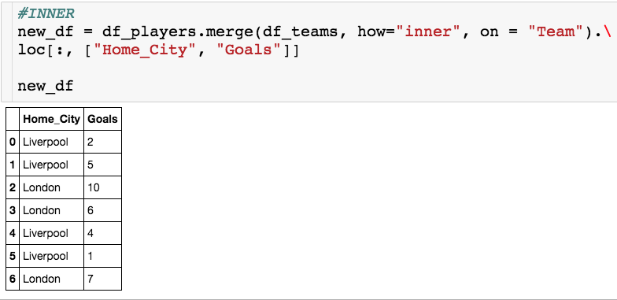
Inner Merge Operation
Now I just need to pick out the rows that correspond to a London based player

Slide 12
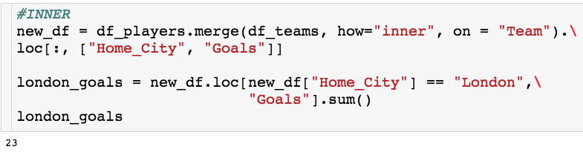
Answering Question 2
How many goals are scored by players in London?

Slide 13
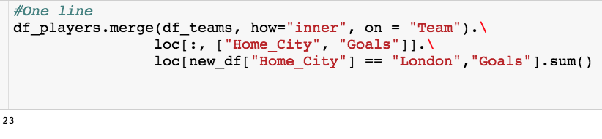
Answering Question 2
How many goals are scored by players in London?

Slide 14
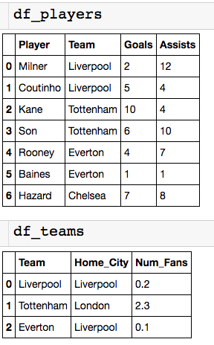
Left Merge Operation
Notice now that Chelsea is missing from the df_tems dataframe

Slide 15
Left Merge Operation
Let’s see what happens when we do a normal JOIN on Team…

Slide 16
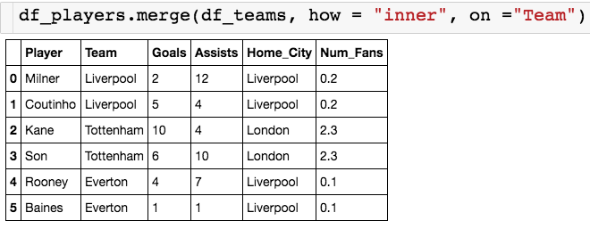
Left Merge Operation
Let’s see what happens when we do a normal JOIN on Team…
We lose the information on Hazard (Chelsea) because Chelsea wasn’t matched with the on!

Slide 17

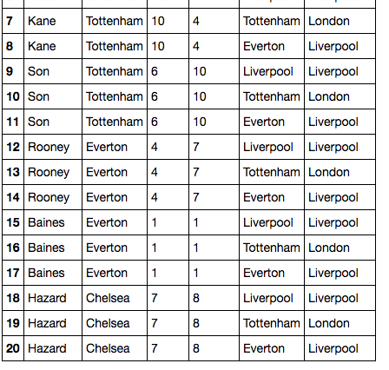
Left Merge Operation

Slide 18
Left Merge Operation

Slide 19
Left Merge Operation
Left merge – If there isn’t a match still keep a copy of the row for the left dataframe

Slide 20
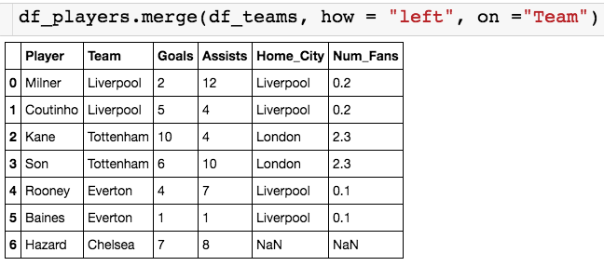
Left Merge Operation
Specify “left”
Get NaN for columns of right df

Slide 21
Left Merge Operation
Specify “left”
Get NaN for columns of right df
Useful if you don’t want to lose data after the ON
There is a RIGHT JOIN … but any RIGHT JOIN can be written as LEFT JOIN

Slide 22
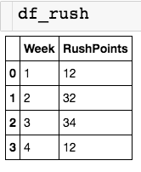
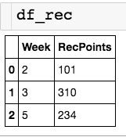
New Data Set
Lets say I wanted to combine the records and put a zero if one of the points categories did not exists for the given week.
An inner merge on Week will get rid of rows 1,4 (from df_rush) and row 5 (from df_rec)
A left join on Week will get rid of row 5 (from df_rec)

Slide 23
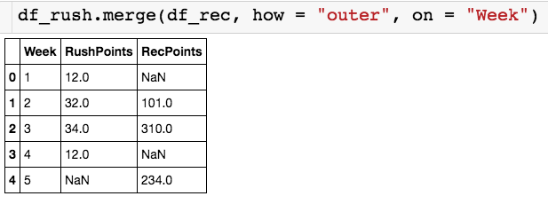
Outer Merge Operation
Specify “outer”
Get NaN when either side can’t find a match

Slide 24
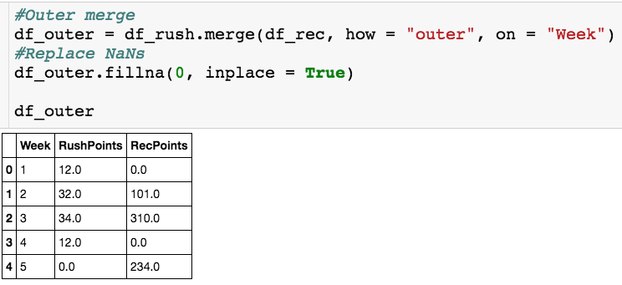
Replace NaNs

